Slide 1


Introduction
ACCESSDATA® FORENSICS
WORKING WITH PRTK
Forensic Analysis
Incident Response
eDiscovery
Information Assurance

Slide 2
Module Objectives
PRTK Overview
  The Interface
  Recovery Modules
  The Golden Dictionary
Starting a Session
  Drag-and-Drop, Analyze Menu
  Importing Dictionaries
  Creating Biographical Dictionaries
  Setting Up Profiles
Utility Integration
  Leveraging the FTK Index in a PRTK Attack
  Utilizing Word Lists
  The AccessData Methodology

Slide 3
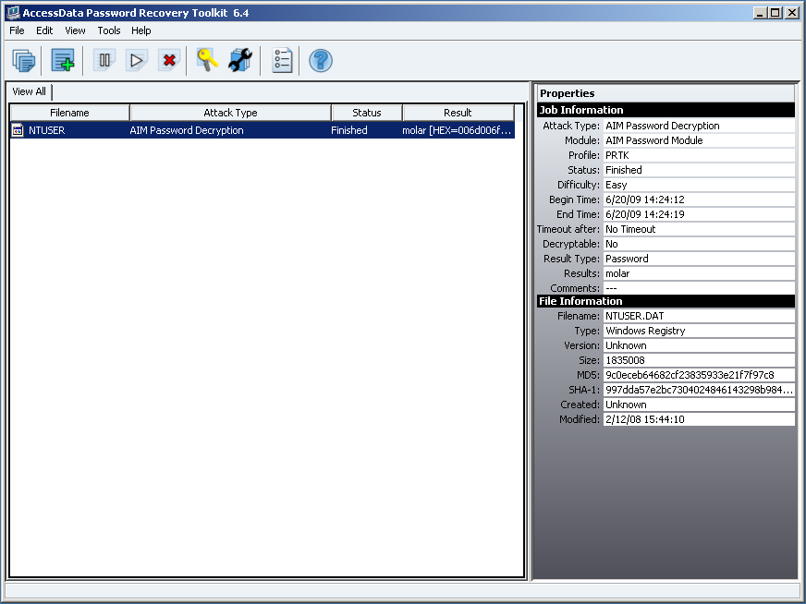
PRTK Overview - Interface

Slide 4
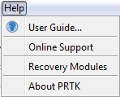
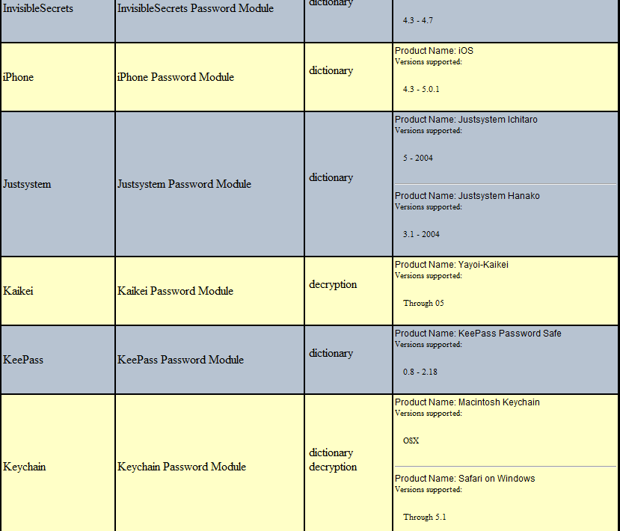
PRTK Overview - Modules

Slide 5

Attack Level - Golden Dictionary
GoldenDictionary.xml = Golden Dictionary

Slide 6
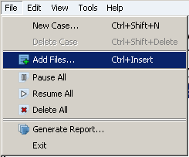
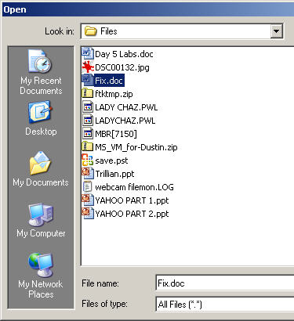
Starting a Session
FIX.DOC
D
R
O
P
D R A G
OR
PRTK

Slide 7
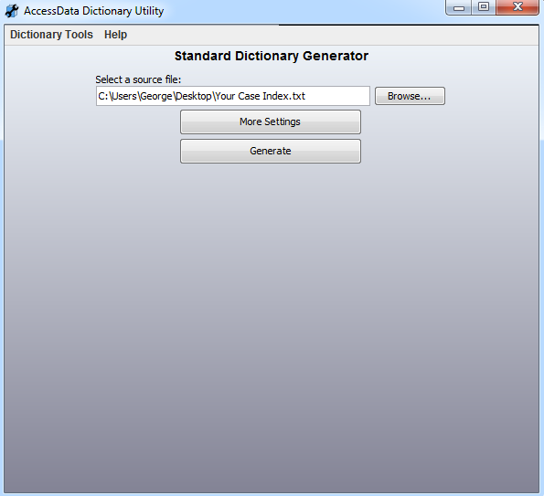
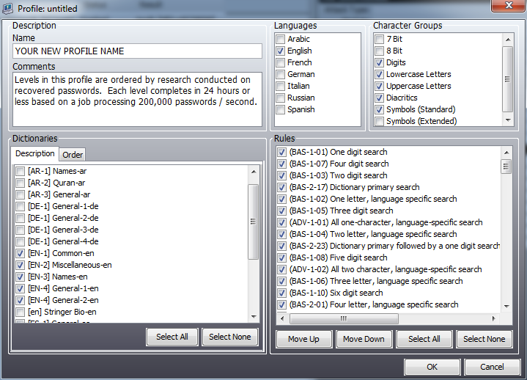
Setup Options
Edit and Import
Dictionaries
Setup
Profiles

Slide 8
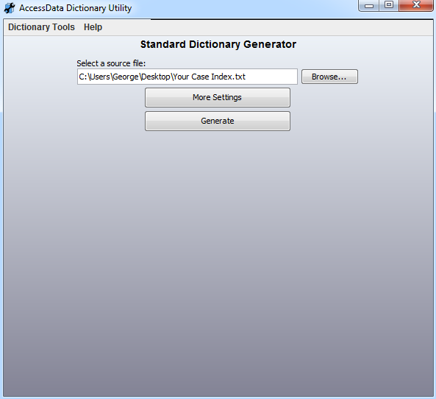
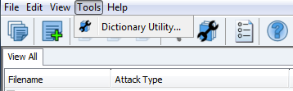
Importing a New Dictionary
Add new dictionaries:
  Full-text index from FTK
  User-created text file

Slide 9
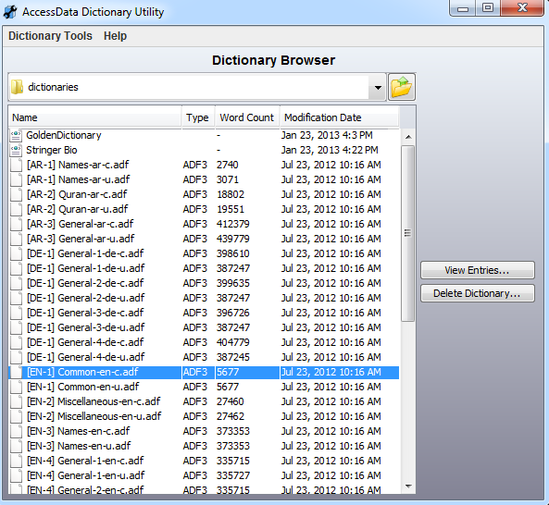
Importing a New Dictionary

Slide 10
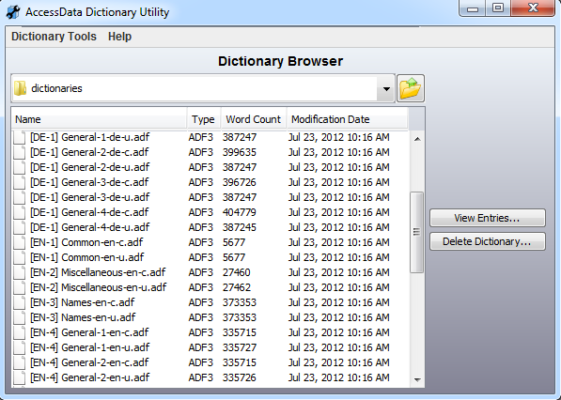
Importing a New Dictionary
Codepage and Unicode
Large dictionaries
segmented at
500,000 words

Slide 11
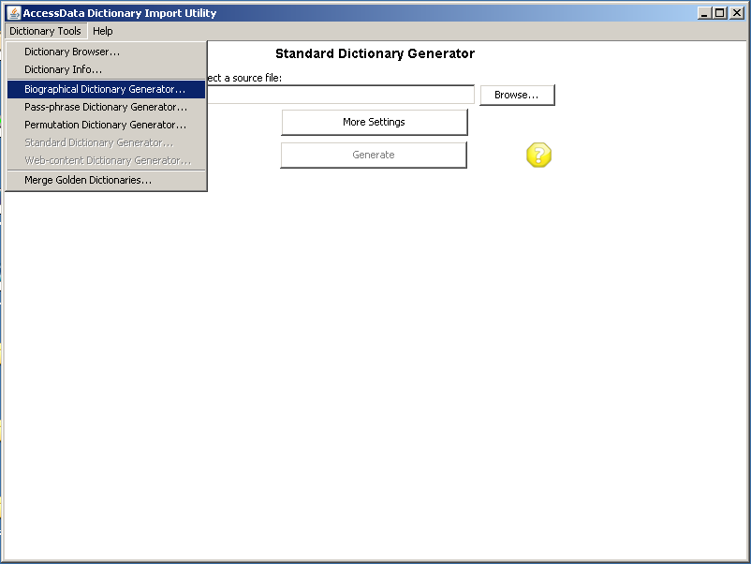
Biographical Dictionary

Slide 12
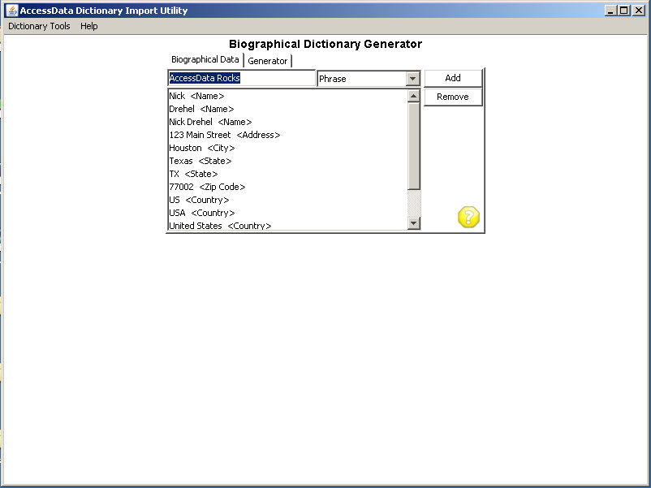
Biographical Dictionary
Add words by category
Consider case sensitive
issues
Consider concatenating
Generate when complete

Slide 13
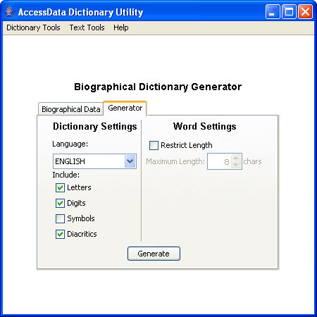
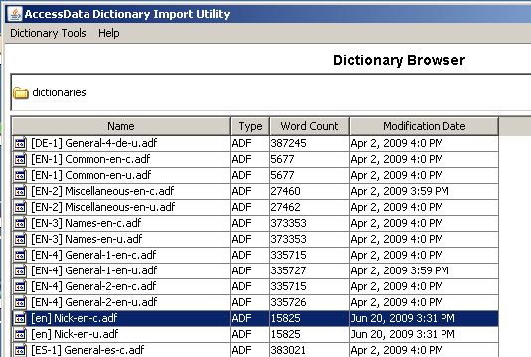
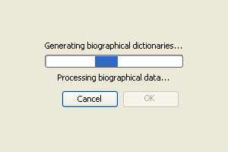
Biographical Dictionary
The 14 entries generated almost 16,000 words in the dictionary!
Results in:
  Codepage
  Unicode
  XML (AS-IS)

Slide 14
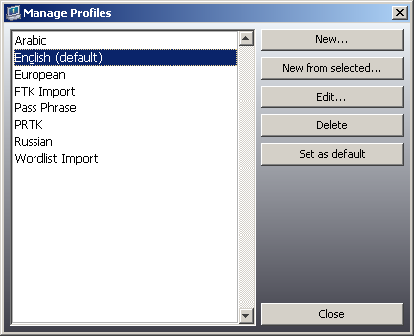
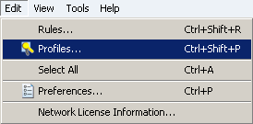
Setting Up a New Profile
Set up a customized profile to dictate how PRTK attacks the encrypted file.

Slide 15
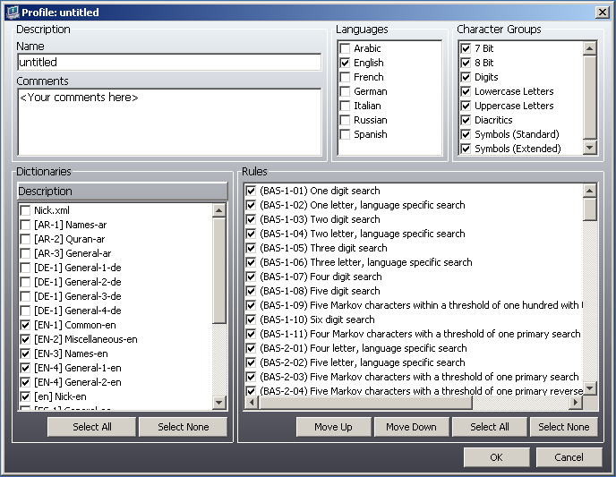
Setting Up a New Profile
1
2
3

Slide 16
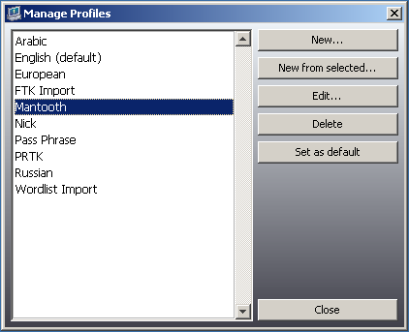
Saving a New Profile

Slide 17
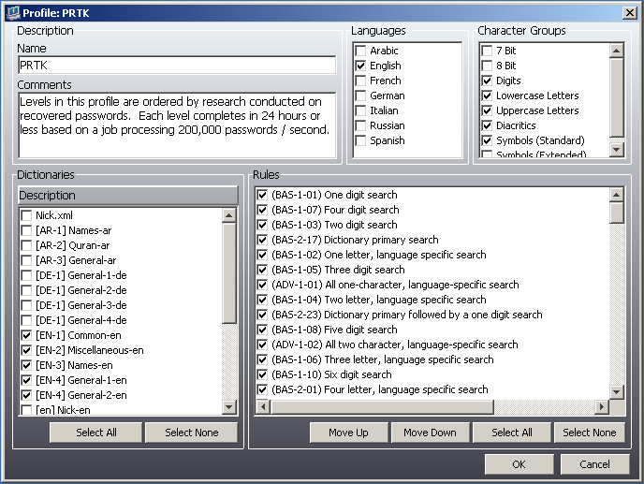
The PRTK Profile
Based on 1,000,000-
password study
Levels are ordered for
efficiency
Designed to complete
in 1 week on average
If unsuccessful,
consider DNA

Slide 18
The PRTK Profile
Use it as a template
Rename, update
dictionary selections,
and save for each
new profile
This was designed for the trained user
Make it your default!

Slide 19
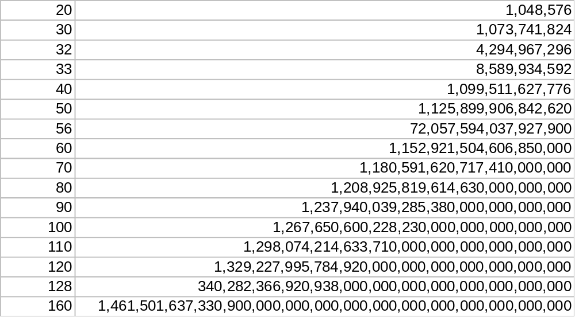
Bit Strength Classification
Easy
Moderate
Difficult
DNA !!
&%@# !!!

Slide 20
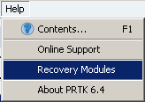
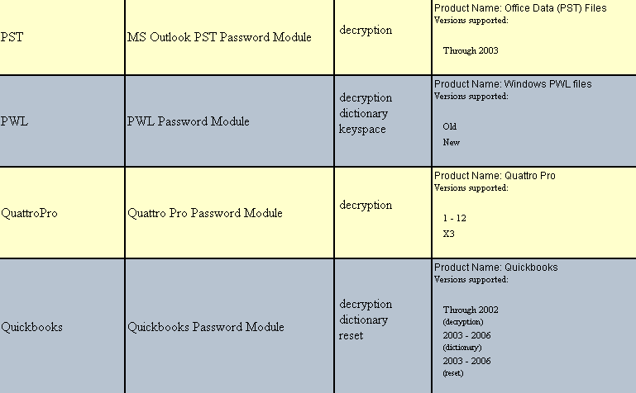
Types of Attacks
Password Reset
Decryption
Dictionary
Key Space

Slide 21
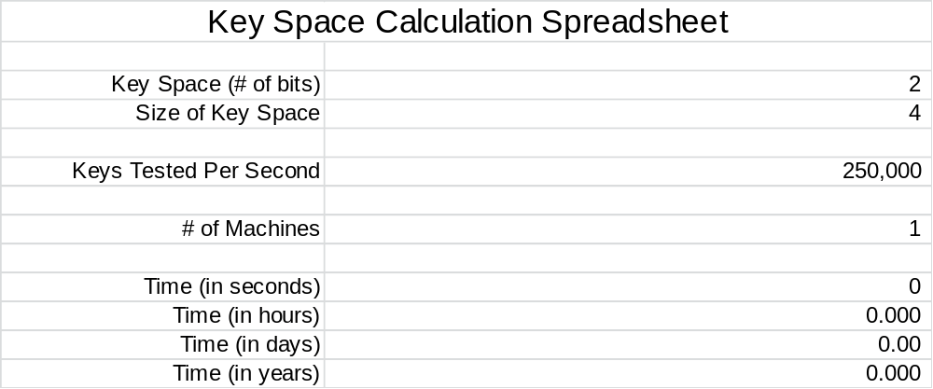
How Big is Big?

Slide 22
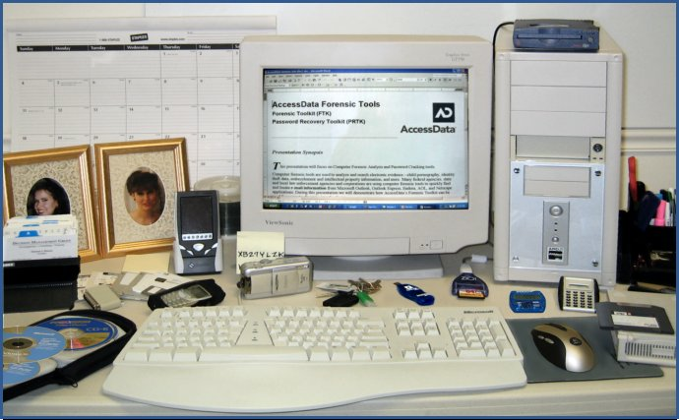
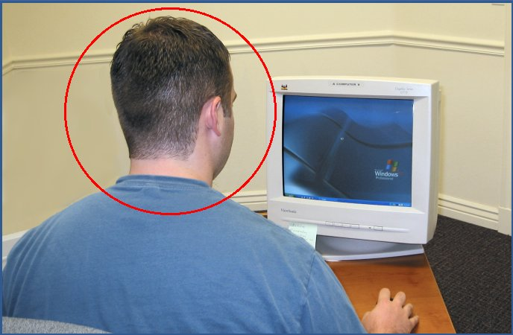
What to Look For?

Slide 23

AccessData Methodology
Send Army Back
Attack
Integrate
New Intel
Take
Prisoners
Special Ops
Interrogate
Gather
Intel

Slide 24
Module Review
PRTK Overview
  The Interface
  Recovery Modules
  The Golden Dictionary
Starting a Session
  Drag-and-Drop, Analyze Menu
  Importing Dictionaries
  Creating Biographical Dictionaries
  Setting Up Profiles
Utility Integration
  Leveraging the FTK Index in a PRTK Attack
  Utilizing Word Lists
  The AccessData Methodology

Slide 25



